Slide 1
Student Performance Analysis

Slide 2
Problems faced by students after test
Which chapter to improve
How to improve score
Where will they stand after improving certain chapters
Where they lack in preparation

Slide 3
What is Student Perfromance Analysis model about?
This model analyses the test and chapter wise performance.
It suggests and sets the target which helps students to improve their performance in up coming test.
Students are made aware of their weak areas, which they are asked to improve.
This model predicts where they would stand on a rank list by improving certain topics.

Slide 4
Walkthrough the model
Test/Chapter wise analysis is done
Ranks that can be achieved is predicted
Students test data is entered in database
Target is set for improvement

Slide 5
Prediction done by the model
1
2
3
Test and chapter wise analysis
Position on rank list
Best combination of subjects
Based on previous
tests the students are informed on which chapter to improve
The postion on rank list is predicted when students achieve the target set for improvement
The model predicts the best combination of subjects based on their strength for improvement in score

Slide 6
Target values set
50%
75%
90%
95%
When the students fail to score min of 50 percent in each chap they are given a tagert to acheive 50 percent for a stable score
Students who score more than 50 percent of score but needs to still improve their score are given a target of 75 percent .
Students who seem to perform well and with little more effort achieve a good score are given a target of 90 percent
Students who have good performace and get around 90 percent are given a target of 95 percent to achieve best score for them

Slide 7
Improvement in Project from prototype presented
01
Usage of Databse to store large data systematically
02
Prediction using ML models for prediction with better accuracy
03
Making of interactive web page and mobile application
04
Collection of real data in large
quantity

Slide 8
Graphs predicted by model

Slide 9
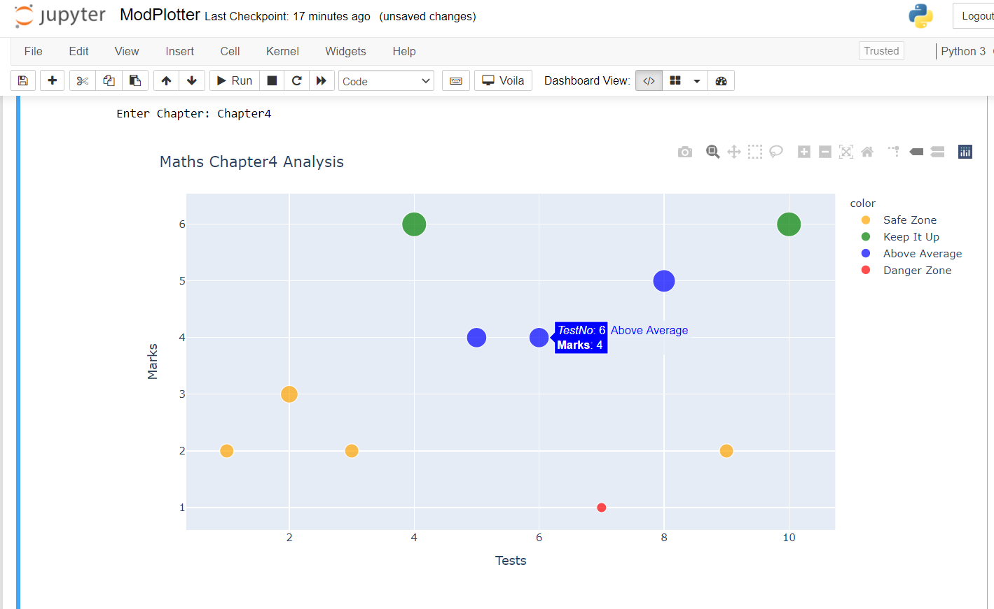

Slide 10
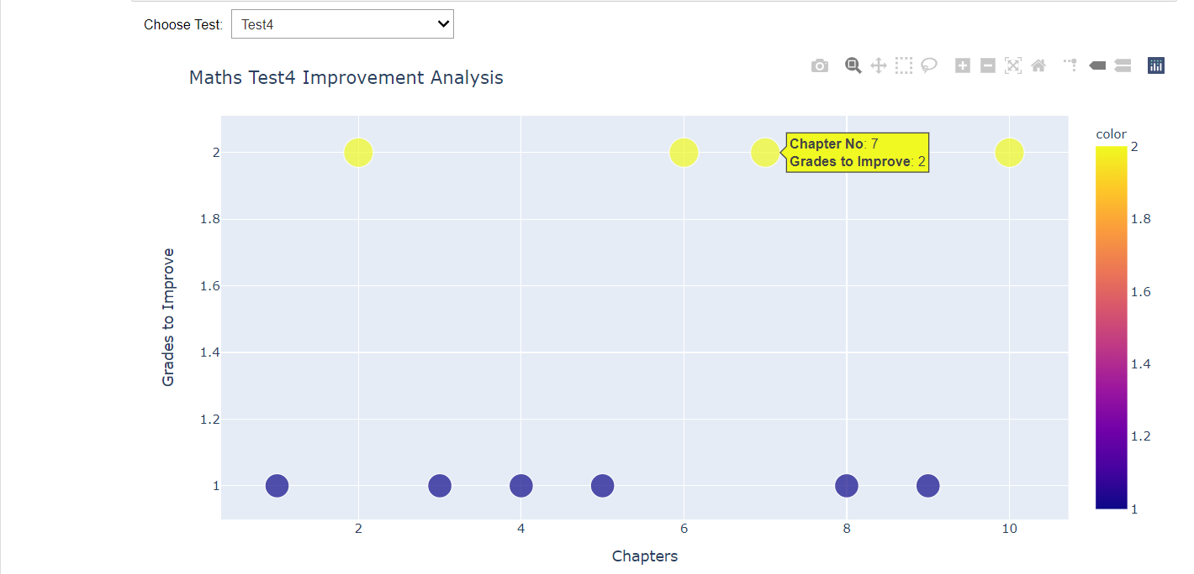

Slide 11
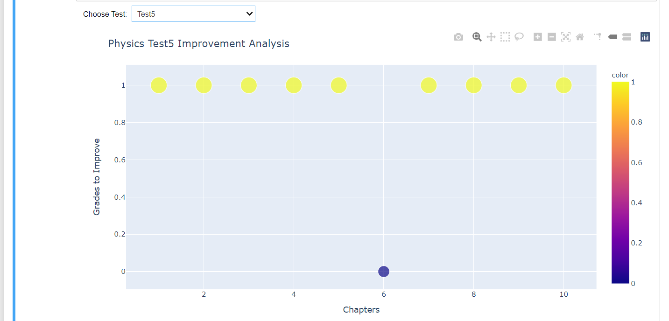

Slide 12
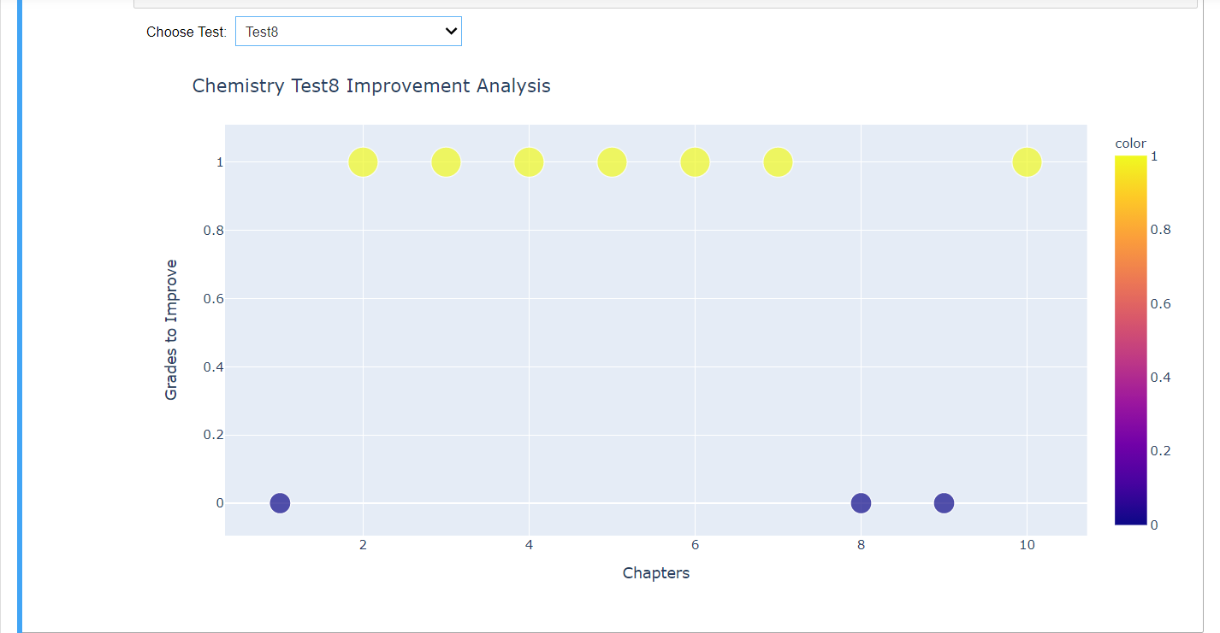

Slide 13
Enter title
Arpita Muleva
Ashwin Prakash
Sathak Gupta
Vishal Kumar

Slide 14
……
THANK YOU
Notes:
模板来自于 http://docer.wps.cn

